Slide 1
Subject: Code: 19ScCMAP105
Software Development Engineering Testing

Slide 2
Today’s Agenda
Introduction To Agile
History Of Agile
Agile Challenges
Agile Promises
What Exactly Is Agile?
Practice of Agile
Agile Methodology And Models
Introduction to Agile Methodology:
Advantages Of Agile Methodology
Types Of Agile Methodologies

Slide 3
Agile in Software Development:
Agile was born when on one fine day when 17 people with differing development methodologies background, got together to brainstorm if there was a possible alternative solution to software development which could lead to faster development time and was less documentation heavy
champions of different software engineering techniques got together and the end result of their meeting was what they called the “agile manifesto’

Slide 4
Agile Challenges
The existing waterfall techniques at that time were too cumbersome and had no provision for feedback until the final product was ready to be delivered.
there was no scope for course correction and the customer had no view on the progress until the whole product was ready
agile is also about being the adaptive and continuous improvement, as much as it is about constant feedback and speed of delivery.

Slide 5
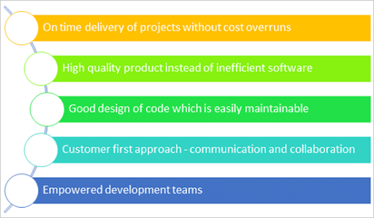
Agile Promises

Slide 6
What Exactly Is Agile?
Agile is a set of principles that encourage flexibility, adaptability, communication and a working software over plans and processes. It is very succinctly captured in what is called the agile manifesto.
Agile methods and methodologies also open a scope for process improvement as an integral part of each delivery.
Agile is a software development approach where a self-sufficient and cross-functional team works on making continuous deliveries through iterations and evolves throughout the process by gathering feedback from the end users.

Slide 7
Practice Of Agile
There are various Agile Methodologies that are in practice in various diversified industries.
However, the most popular methodologies amongst all of them are:
Scrum
Kanban
Extreme Programming
All these methodologies focus on lean software development and help in building better software effectively and efficiently.

Slide 8
Introduction to Agile Methodology
Agile is a software development methodology
values and principles which were mentioned in the agile manifesto by the founders of agile

Slide 9
Advantages Of Agile Methodology
The customers continuously get a look and feel of the project progress at the end of each iteration/sprint.
Each sprint provides the customer with a working software which meets their expectations as per the definition of done provided by them.
The development teams are quite responsive to the changing requirements and can accommodate changes even in the advanced stages of development.
There is a constant two-way communication which keeps the customers involved, thus all stakeholders – business and technical – have a clear visibility on the project's progress.
The design of the product is efficient and fulfills the business requirements

Slide 10
Disadvantages Of Agile Methodology
Comprehensive documentation is not preferred which can lead to agile teams incorrectly interpreting this as agile doesn’t require documentation.
at the beginning of the projects, the requirements are not crystal clear. The teams might proceed and find that the customers' vision got realigned and in such situations, the teams need to incorporate many changes and it is difficult to gauge the end result as well.

Slide 11
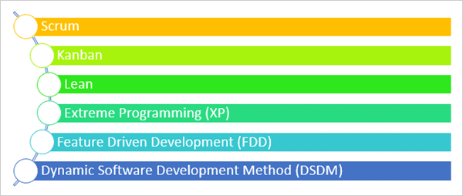
Types Of Agile Methodologies

Slide 12
Scrum
Scrum can easily be considered to be the most popular agile framework
Scrum is just one of the frameworks by which you can implement agile
The word scrum comes from the sports rugby
the scrum in IT believes in empowered self-managed development teams with three specific and clearly defined roles.

Slide 13
Scrum Continued
These roles include – Product Owner (PO), Scrum Master (SM) and the development team consisting of the programmers and testers. They work together in iterative time boxed durations called sprints.
The first step is the creation of the product backlog by the PO. It’s a to-do list of stuff to be done by the scrum team
The scrum team selects the top priority items and tries to finish them within the time box called a sprint

Slide 14
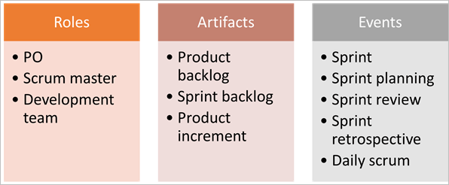
Scrum Continued
Roles: PO, Scrum master, and development team.
Artifacts: Product Backlog, Sprint Backlog and Product increment.
Events: Sprint, Sprint planning, Daily Scrum, Sprint review and Sprint retrospective.

Slide 15
Kanban
Kanban is a Japanese term which means a card
The purpose is visualization.
Teams use these Kanban cards for continuous delivery
of product backlogs, Kanban has no such requirement and it is totally optional. Thus Kanban requires less organization and avoids non-value adding activities and is suitable for the processes which require responsiveness towards changes

Slide 16
Lean
Lean is a philosophy that focuses on waste reduction
In lean, you divide a process into value-adding activities, non-value adding activities and essential non-value adding activities
Any activity which can be classified as a non-value adding activity is a waste and we should try to remove that wastage in the process to make it leaner
A leaner process means faster delivery and less effort wasted in tasks which don’t help to achieve the team goals

Slide 17
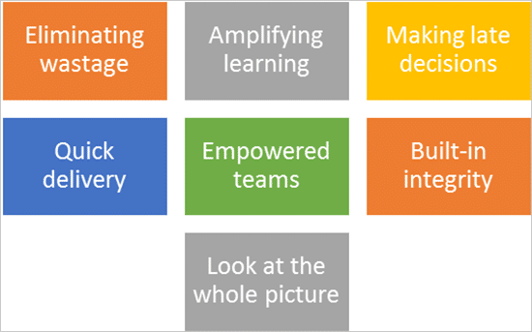
Lean Continued

Slide 18
Lean continued
A non-value add activity can be any part of the code which might make it less robust, increase the effort involved and take up a lot of time while not adding justifiable business value
easy to understand as a team needs various skills to deliver products in a rapidly changing environment with new technologies cropping up in quick durations.
Making late decisions can be rewarding in circumstances where it reduces rework like if there are any changes expected then better delay it so that the team does not have to redo the work as the business needs change.

Slide 19
Extreme Programming (XP)
Extreme programming is another most popular agile techniques. As per extremeprogramming.org, the first XP project was started on March 6, 1996
XP impacts software project development in 5 different ways – communication, simplicity, feedback, respect, and courage. These are called the values of XP
it all starts with communication. XP teams collaborate with business teams and fellow programmers on a regular basis and start building a code from the very first day.

Slide 20
Extreme Programming (XP) Continued
Extreme programmers also build a simple code and start getting feedback on it from the first day itself
This keeps the design simple and produces just the minimum product which will serve the requirements
Feedback helps the team to improve and produce a better quality of work

Slide 21
Scrum Methodology
SCRUM is a process in agile methodology which is a combination of the Iterative model and the incremental model.
In the agile Scrum world, instead of providing complete, detailed descriptions of how everything is to be done on a project, much of it is left up to the Scrum software development team
Scrum relies on a self-organizing, cross-functional team.

Slide 22
Characteristics of SCRUM include:
Self-organized and focused team
No huge requirement documents, rather have a very precise and to the point stories
The cross-functional teams work together as a single unit
Close communication with the user representative to understand the features
Has a definite timeline of maximum one month
Instead of doing the entire “thing” at a time, Scrum does a little of everything at a given interval

Slide 23
Scrum Terminologies
Scrum Team
Sprint
Product Owner
Scrum Master
Business Analyst
User Story
Epics
Product Backlog
Story Points
Burn Down Chart
Velocity

Slide 24
SCRUM Terminologies
Scrum Team
Scrum team is a team comprising of 7 with + or – two members. These members are a mixture of competencies and comprise of developers, testers, database people, support people etc. along with the product owner and a scrum master.
SCRUM team sitting arrangement plays a very important role in their interaction, they never sit in cubicles or cabins, but a huge table.

Slide 25
SCRUM Terminologies Continued
Sprint
Sprint is a predefined interval or time frame in which the work has to be completed and make it ready for review or ready for production deployment. This time box usually lies between 2 weeks to 1 month.

Slide 26
SCRUM Terminologies Continued
Product Owner
The product owner is the key stakeholder or the lead user of the application to be developed. The product owner is the person who represents the customer side. He/she has the final authority and should always be available for the team

Slide 27
SCRUM Terminologies Continued
Product Owner
The product owner is the key stakeholder or the lead user of the application to be developed. The product owner is the person who represents the customer side. He/she has the final authority and should always be available for the team.
It is important for the product owner to understand and not to assign any new requirement in the middle of the sprint or when the sprint has already started.

Slide 28
SCRUM Terminologies Continued
Scrum Master
Scrum Master is the facilitator of the scrum team. He/she makes sure that the scrum team is productive and progressive. In case of any impediments, scrum master follows up and resolves them for the team. SCRUM Master is the mediator between the PO and the team.
If there are any roadblocks or concerns for the team, discusses with the PO and gets them resolved.

Slide 29
SCRUM Terminologies Continued
Business Analyst (BA)
A Business Analyst plays a very important role in SCRUM. This person is responsible for getting the requirement finali
If there are any ambiguities in the User Stories / Acceptance criteria, he/she is the one who is approached by the technical (SCRUM) team and he then takes it up to the PO or else if possible resolves on his own.

Slide 30
SCRUM Terminologies Continued
User Story
User stories are nothing but the requirements or feature which has to be implemented.
In the scrum, we don’t have those huge requirements documents, rather the requirements are defined in a single paragraph, typically having the format as:
As a <User / type of user>
I want to <Some achievable goal/target>
To achieve <some result or reason for doing the thing>

Slide 31
SCRUM Terminologies Continued
Epics
Epics are equivocal user stories or we can say that these are the user stories which are not defined and are kept for future sprints.

Slide 32
Product Backlog
The product backlog is a kind of bucket or source where all the user stories are kept. This is maintained by the Product Owner. Product backlog can be imagined as a wish list of the product owner who prioritizes it as per the business needs.

Slide 33
Sprint Backlog
Based on the priority, user stories are taken from the Product Backlog as one at a time. The Scrum team brainstorms on it determines the feasibility and decides on the stories to work on a particular sprint. The collective list of all the user stories which the scrum team works on a particular sprint is known as Sprint backlog.
+++ Img need to add +++

Slide 34
Story Points
Story points are a quantitative indication of the complexity of a user story. Based on the story point, estimation and efforts for a story are determined.
A story point is relative and not absolute. In order to make sure that our estimate and efforts are correct, it’s important to check that the user stories are not big. The more precise and smaller is the user story, the more accurate will be the estimation.

Slide 35
Whenever you are deciding on a story point, keep the below factors in mind:
The dependency of the story with other application/module.
The skill-set of the resource.
The complexity of the story.
Historical learning.
Acceptance criteria of the user story.

Slide 36
Burn down chart
Burn down chart is a graph which shows the estimated v/s actual effort of the scrum tasks.
It is a tracking mechanism by which for a particular sprint the day to day tasks are tracked to check whether the stories are progressing towards the completion of the committed story points or not.

Slide 37
Img need to add

Slide 38
“Story”-> This column shows the user stories taken for the sprint.
“Task” -> This column shows the list of the task associated with the user story.
“Effort” -> This column shows the effort. Now, this measure is the total effort to complete the task. It does not depict the effort put in by any specific individual.
“Day 1 – Day 10” -> This column(s) shows the hours which are left to complete the story. Please see that the hour is NOT the hour which is already done BUT the hours which are still left.
“Estimated Effort” -> Is the total of the effort. For the “Start” it is simply the sum of the entire individual task: SUM (C5: C15)
A total number of effort that has to be completed in 1 day is 70 / 10 = 7. So at the end of day 1, the effort should reduce to 70 – 7 = 63. In a similar way, it is calculated for all the days till day 10, when the estimated effort should be 0 (Row 16)
“Actual Effort Left” -> As the name suggests, is the effort actually left to complete the story. It may also happen that the actual efforts increases or decreases than the estimated one.

Slide 40
Burn Down Chart steps would be:
Enter all the stories ( Column A5 – A15).
Enter all the Tasks ( Column B5 – B15).
Enter the Days ( Day 1 – Day 10 ).
Enter the starting efforts (Sum the tasks C5 – C15 ).
Apply the formula to calculate the “Estimated Efforts” for each day (Day 1 to Day 10). Enter the formula at D15 (C16-$C$16/10) and drag it for all the days.
For each day, enter the actual efforts. Enter the formula at D17 (SUM (D5:D15)) for summing up the actual efforts left, and drag it for all the other days.
Select it and create the chart as follows:

Slide 41
IMG need to add

Slide 42
Velocity
The total number of story point which a scrum team archives in a sprint, is called Velocity. The Scrum team is judged or referenced by its velocity. Having said that, it should be kept in mind that the objective here is NOT achieving the maximum story points, but to have a quality deliverable, respecting the scrum team’s comfort level.

Slide 43
Activities Done In SCRUM Methodology

